Slide 1
Weekly report: Foundation Team
Week number: 02
Date: 14/10/2025
Supervisor: Prof. Dr.-Ing. Torsten Faber
Group members : Jehad Albaali- Amgad Gerges - Reda Deif

Slide 2
List of content
Project Overview & Objectives
Input Data (Loads & Soil Properties)
Foundation Design & Stability Checks
Tasks for Next Week
Reda Deif
Foundations team/ Optimus Syria

Slide 3
Design of a Safe Wind Turbine Foundation
Objective: Design a concrete foundation that prevents
Sliding
Overturning
Bearing Failure
Turbine Data :
Hub Height = 100 m
Rotor Diameter = 160 m
Site: Qattinah (B2)
Foundation Type: Circular Gravity Foundation
Reda Deif
Foundations team/ Optimus Syria

Slide 4
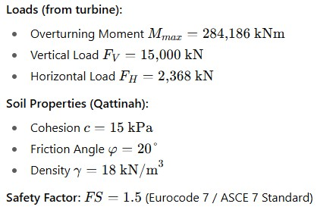
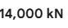
Input Data :
Sources Loads (Loads Team ) (Soil Properties) : DAMASCUS UNIVERSITY REPORT preliminary geotechnical survey at WT project Eurocode 7 / ASCE 7
Reda Deif
Foundations team/ Optimus Syria

Slide 5
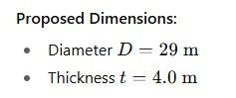
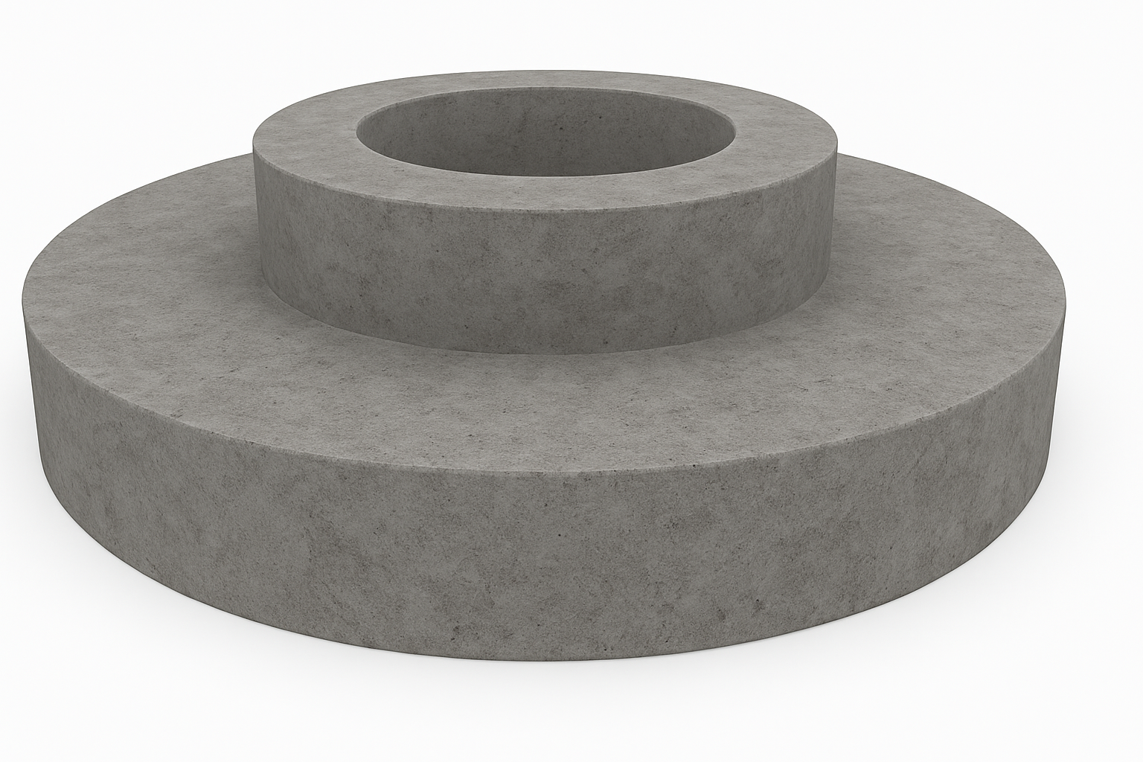
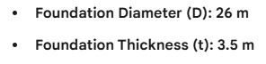
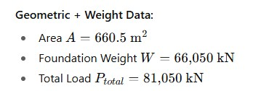
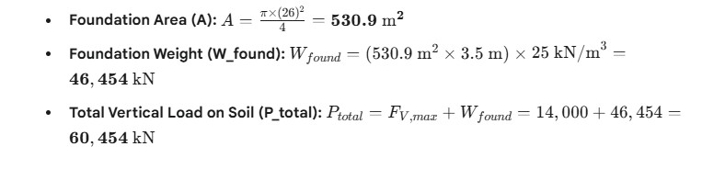
Dimensions
Reda Deif
Foundations team/ Optimus Syria

Slide 6
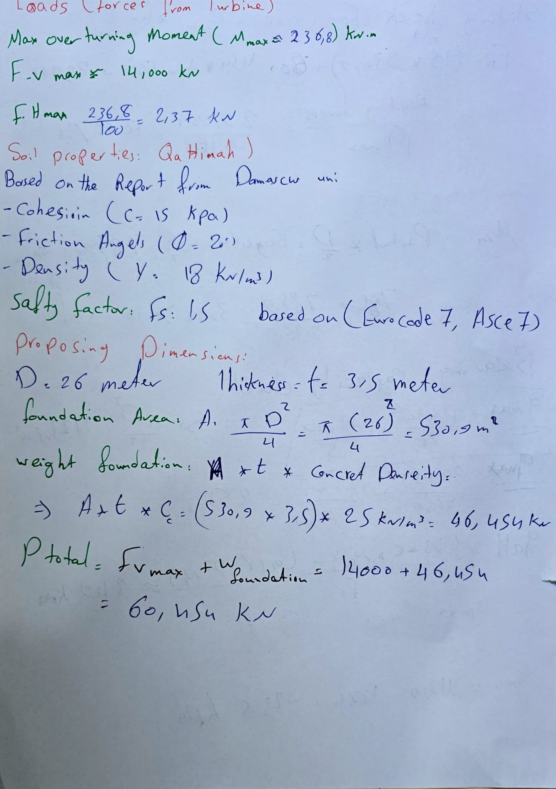
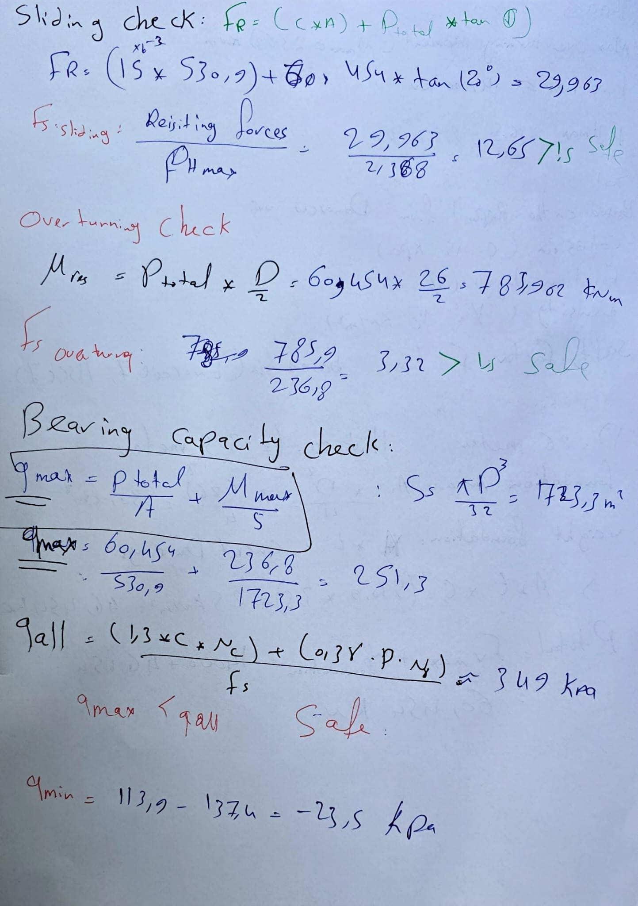
Hand Calculation
Reda Deif
Foundations team/ Optimus Syria

Slide 7
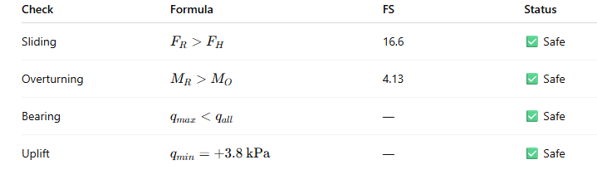
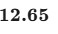
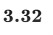
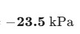
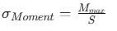
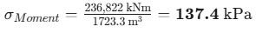
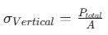
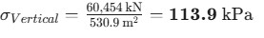
Stability Results & Optimization
Reda Deif
Foundations team/ Optimus Syria

Slide 8
Next Task
Verify the final vertical load value (F_V,max) with the tower design team.
Redesign and optimize the foundation according the new input data
Estimation of the top foundation design
Reda Deif
Foundations team/ Optimus Syria

Slide 9
References
GeeksforGeeks - Terzaghi’s Bearing Capacity Theory https://youtu.be/tr0yOf4JaYU?si=J4FceamERS_vV4fq
Sources for Bearing Capacity Factors (Nc, Nq, Nγ) Tables https://civilengineeringx.com/foundation/terzaghis-bearing-capacity-theory/#gsc.tab=0
Eurocode 7: Geotechnical Design
chrome-extension://efaidnbmnnnibpcajpcglclefindmkaj/https://eurocodes.jrc.ec.europa.eu/sites/default/files/2022-06/02-Scarpelli-Design-of-spread-foundations.pdf
Reda Deif
Foundations team/ Optimus Syria

